Slide 1
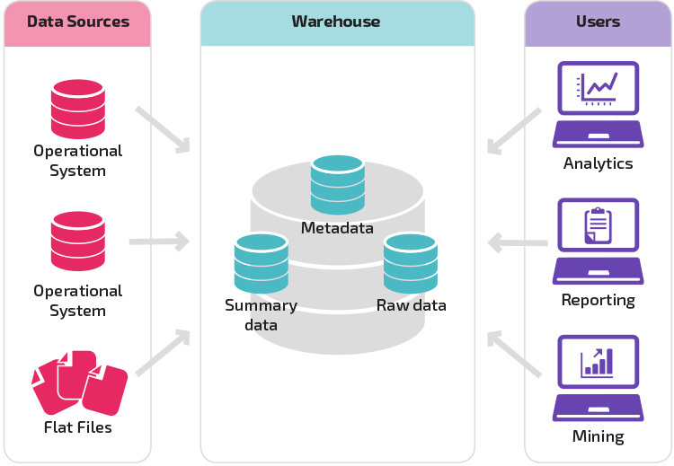
Data Warehouse - What is it ?

Slide 2
Data Warehouse - Options
Problems with Traditional Data Warehouses :
Scalability
Meant for OLTP Processing (Row oriented & Normazlied )
No Distributed Processing
No Concurrency
Single Point of failure
Cloud Data Warehouses :
On-Demand Scalability
OLAP (Columnar databases)
Concurrency and distributed work loads
No Single point of failure
Zero Overhead and maintenance

Slide 3
Data Warehouse - Options
Traditional Solutions for Data Warehouse :
SQL Server
PostgreSQL
MySql
Cloud Data Warehouses :
BigQUery (Google Cloud)
Redshift (Amazon Cloud)
Snowflake
Other Options :
AWS Athena
Hadoop Hive

Slide 5
Building a data-warehouse/lake solution on Cloud
1 - Data-warehouse management (Strong SQL & Data Modelling Skills ):
Data Modelling
Optimizing Queries
Billing/Cost management
User / Access Management
Enabling BI/Analytics for decision making
Data Governance and Security
2 - ETL/Data Movement (Strong Scripting/Coding skills along with understanding of cloud components )
Writing Pipelines using scala/java/python
Data orchestration tools (Airflow,Step Functions)
Deployment and integration of analytics/ML Models
Know-how 0f best solutions for deploying scalable pipelines
Logging , alerting and notifications

